Slide 1
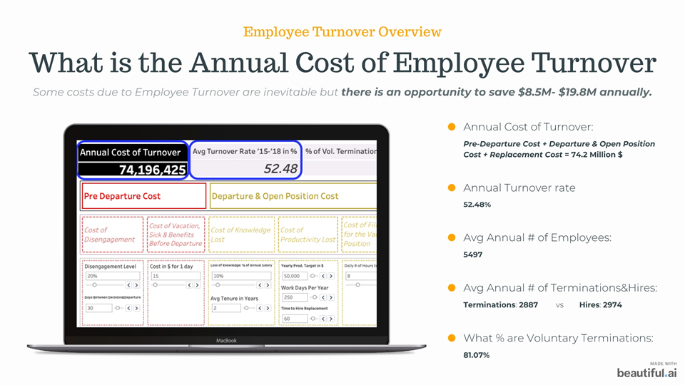

Slide 2


Slide 3

Executive Summary

Slide 4
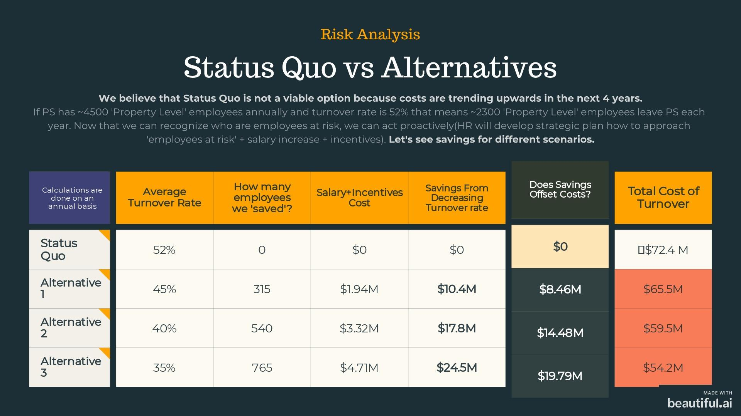

Slide 5
